Slide 1
Lesson 7:
Exploratory Data Analysis(Part 1)

Slide 2
Purpose of EDA
The purpose of exploratory data analysis is to:
Check for missing data, outliers and other anomalies.
Find insight into the data and identify the most important variables.
Uncover an approximate model, one which explains the data with a minimum number of predictor variables.
Testing a hypothesis / checking assumptions related to a specific model.
Find parameter estimates and their associated confidence intervals or margins of error(tolerance).

Slide 3
Order of Exploratory Data Analysis(EDA) Report
Dataset
Objective
Data preprocessing
Univariate analysis
Non Graphical
Graphical
Bivariate analysis
Non Graphical
Graphical
Multivariate analysis
Non Graphical
Graphical
Findings
Non Graphical description include getting insight about the data such as understanding the basic descriptive statistics(mean, median, mode, standard deviation etc.)
Graphical description include visualizing the variable to get the idea about the distribution of the variable(Uniform, Normal, Exponential etc.)

Slide 4
Again we will start our studies with a case study
It is divided into two classes: EDA-1 and EDA-2

Slide 5
Let’s get started then
Step 1: Dataset : Iris Dataset
Step 2: Objective: Given the 4 features (sepal length, sepal width, petal length and petal width) of a new flower, Our task is to classification that into one of the three species.i.e Iris setosa, Iris versicolor, Iris virginica
For more information check out https://en.wikipedia.org/wiki/Iris_flower_data_set
Independent Variable: Sepal Length, Sepal Width, Petal Length, Petal Width
Dependent Variable: Species

Slide 6
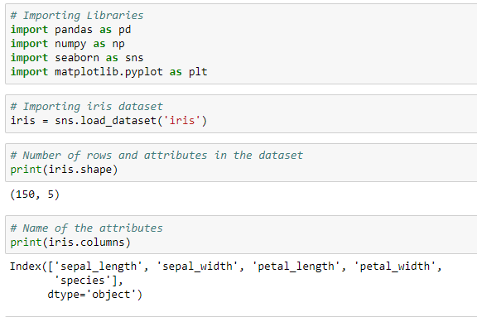
Getting to know the dataset

Slide 7
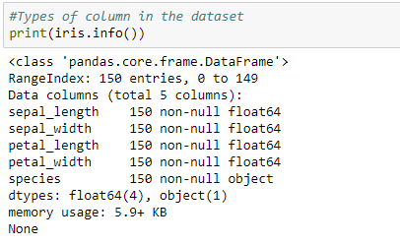
Getting to know the dataset

Slide 8
Step 3: Data Preprocessing
Real-world data is often incomplete, inconsistent, and/or lacking in certain behaviors or trends, and is likely to contain many errors.
Data preprocessing is a proven method of resolving such issues.
Data Cleaning: Data is cleansed through processes such as filling in missing values, smoothing the noisy data, or resolving the inconsistencies in the data.
Data Integration: Data with different representations are put together and conflicts within the data are resolved.
Data Transformation: Data is normalized, aggregated and generalized.
Data Reduction: This step aims to present a reduced representation of the data in a data warehouse.
Data Discretization: Involves the reduction of a number of values of a continuous attribute by dividing the range of attribute intervals.

Slide 9
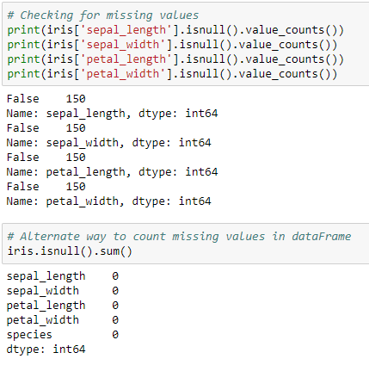
Checking for missing values in the dataset
Examining this is important because when some of your data is missing, the data set can lose expressiveness, which can lead to weak or biased analyses.
Practically, this means that when you're missing values for certain features, the chances of your classification or predictions for the data being off only increase.

Slide 10
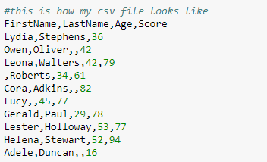
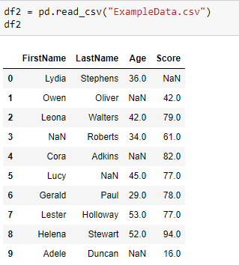
Handling Missing Values
Let us now see how we can handle missing values (say NA or NaN) using Pandas.
Let us now see how we can handle missing values (say NA or NaN) using Pandas.

Slide 11
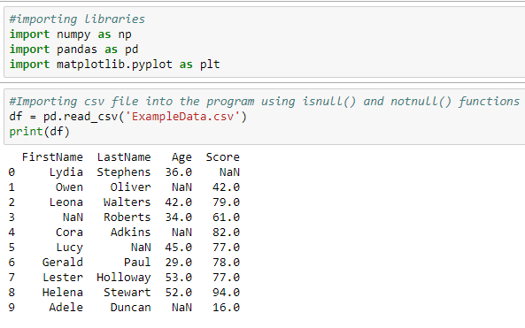
Handling Missing Values

Slide 12
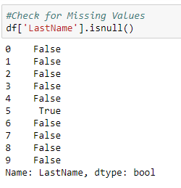
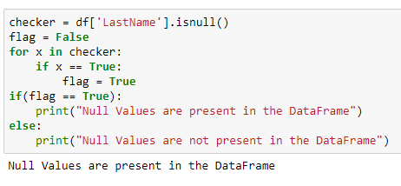
Handling Missing Values

Slide 13
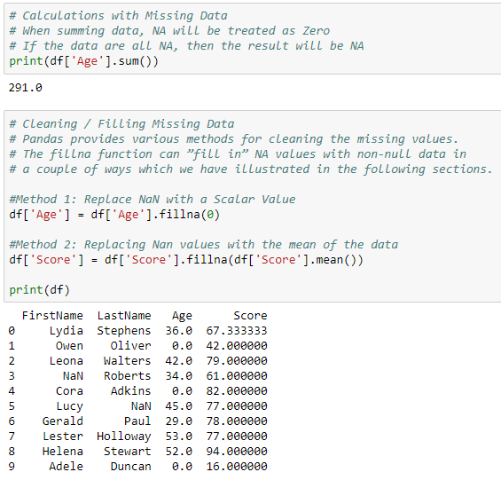
Handling Missing Values

Slide 14
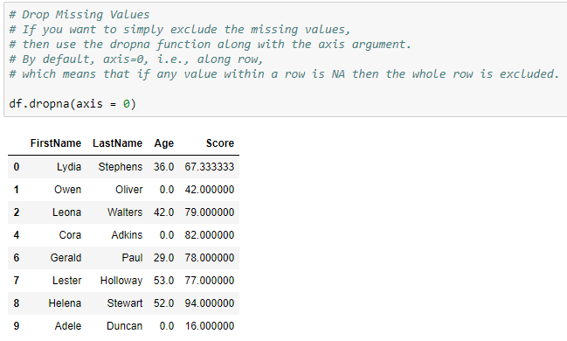
Handling Missing Values

Slide 15
Step 4: Univariate Analysis
Univariate analysis looks at one variable at a time. When we analyze a feature independently, we are usually mostly interested in the distribution of its values and ignore the other variables in the dataset.
Features:
Quantitative features: Quantitative features take on ordered numerical values. Those values can be discrete, like integers, or continuous, like real numbers, and usually express a count or a measurement.
Histograms and kernel density plots
Box Plots
Categorical and binary features: Categorical features take on a fixed number of values. Each of these values assigns an observation to a corresponding group, known as a category, which reflects some qualitative property of dataset.
Bar plot

Slide 16
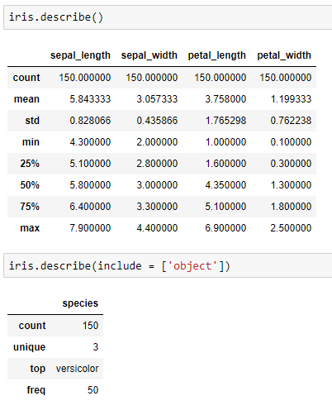
Step 4: Univariate Analysis(Non Graphical)

Slide 17
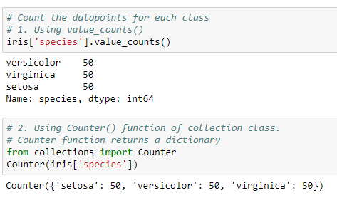
Step 4: Univariate Analysis(Non Graphical)
Balanced and Unbalanced dataset.
Balanced dataset: Where the number of observations belonging to each class is almost equal.
Unbalanced dataset: Where the number of observations belonging to one class is significantly lower than those belonging to the other classes.

Slide 18
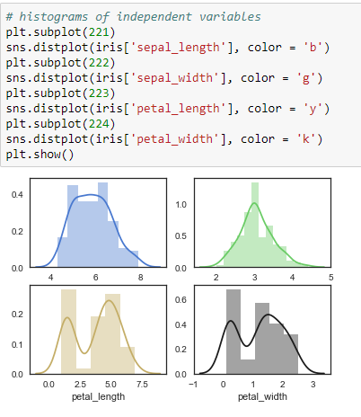
Step 4: Univariate Analysis(Graphical)
A histogram groups values into bins of equal value range. The shape of the histogram may contain clues about the underlying distribution type: Gaussian, exponential etc.
We can use distplot() or kdeplot() functions to create histograms.

Slide 19
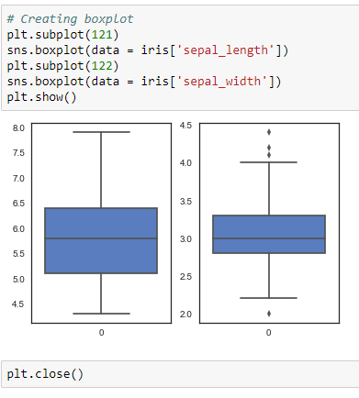
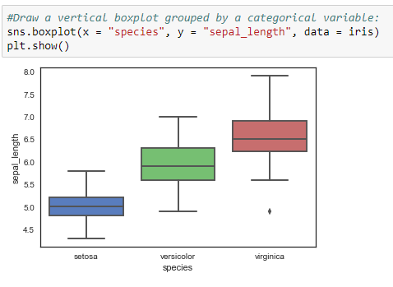
Step 4: Univariate Analysis(Graphical)

Slide 20
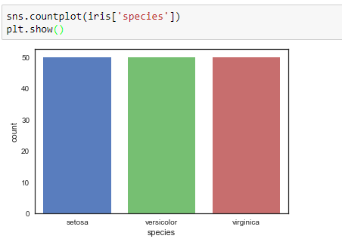
Step 4: Univariate Analysis(Graphical)
The bar plot is a graphical representation of the frequency . The easiest way to create it
is to use the seaborn's function countplot()

Slide 21
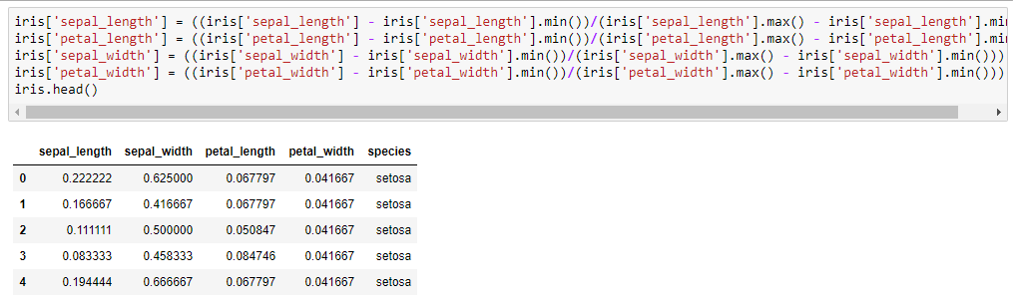
Normalization or Standardization
It means adjusting values measured on different scales to a notionally common scale.
Types of Normalization:
Standard score is used when population parameters are known.
It Works well for populations that are normally distributed.
X = ((X - mean)/(s.d))
Feature scaling is used to bring all values into the range [0,1].
This is also called unity-based normalization.
X = ((X - Xmin)/(Xmax - Xmin))

Slide 22
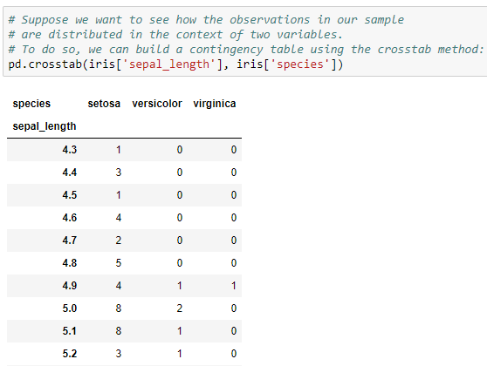
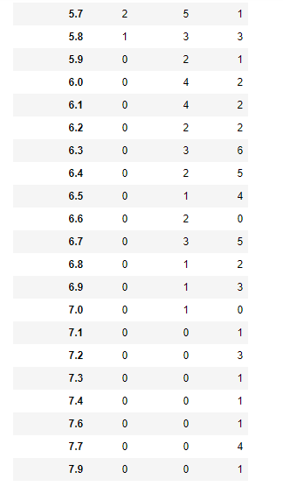
Contingency Table

Slide 23
We’ll continue in next class..
Any questions?

